Slide 1
Movielens Data Analysis and Case Study
Python Project
Student: Swati Nayak
Trainer: Sunny

Slide 2
INTRODUCTION
Domain: Entertainment Industry
Project Background : The GroupLens Research Project is a research group in the Department of Computer Science and Engineering in the University of Minnesota. The researchers of this group are involved in many research projects related to the fields of information filtering, collaborative filtering, and recommender systems. Here, It is asked to perform the analysis for Movielens case study.
Problem Objective: Perform the analysis using the Exploratory Data Analysis technique, find features affecting the ratings of any particular movie and apply the tools of machine learning to build a model to predict the movie ratings.
Data Information:
users dataset
User_id – unique id for each user
Age – user’s age
Gender – user’s gender (M or F)
Occupation – user’s occupation
Zip-code – zip-code for user’s location
rating dataset
User_id- unique id for each user
Movie_id - unique id for each movie
Rating – user rating for each movie
Timestamp – timestamp generated while adding review
movies dataset
Movie_id - unique id for each movie
Title – movie name
Genres – category of each movie
Analysis Tasks to be performed:
Import the three datasets.
users dataset
rating dataset
movies dataset
Create a new Master dataset by joining three datasets.
Perform the Exploratory Data Analysis (EDA)
Visualize user age distribution
Visualize overall rating by users the movie “Toy Story”
Find and visualize the top 25 movies by viewership rating
Find and Visualize the rating and for a particular user of user id = 2696

Slide 3
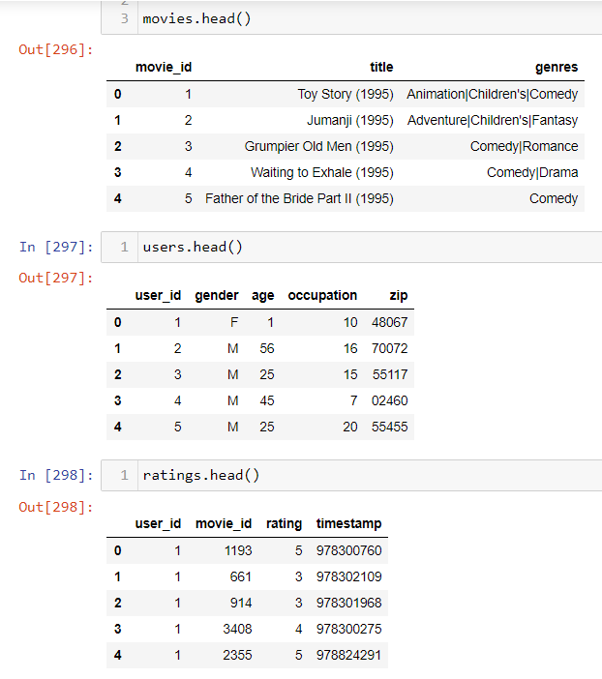
Analysis Tasks to be performed (cont.):
Created a new Master dataset by joining three datasets.
Performed the Exploratory Data Analysis (EDA)
Visualize user age distribution
Visualize overall rating by users
Find and visualize the user rating of the movie “Toy Story”
Find and visualize the top 25 movies by viewership rating
Find and Visualize the rating and for a particular user of user id = 2696
Feature Engineering:
Use column genres:
Find out all the unique genres
Create a separate column for each genre category with a one-hot encoding (1 and 0) whether or not the movie belongs to that genre.
Determine the features affecting the ratings of any particular movie.
Develop an appropriate model to predict the movie ratings
Analysis tasks and Screen shots of Results:
Imported datasets.

Slide 4
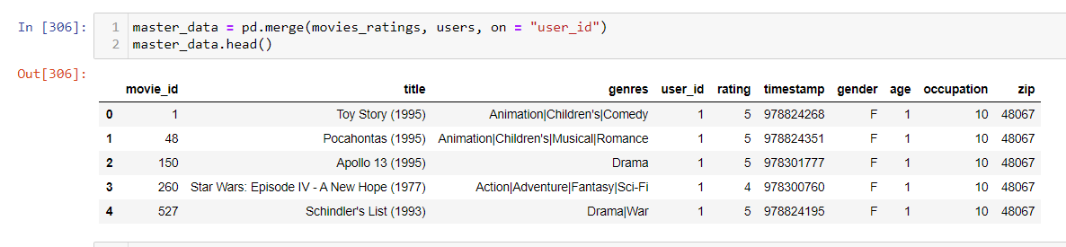
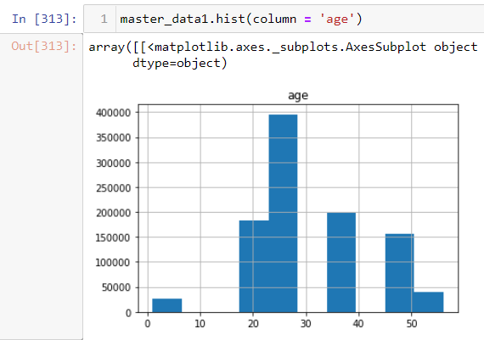
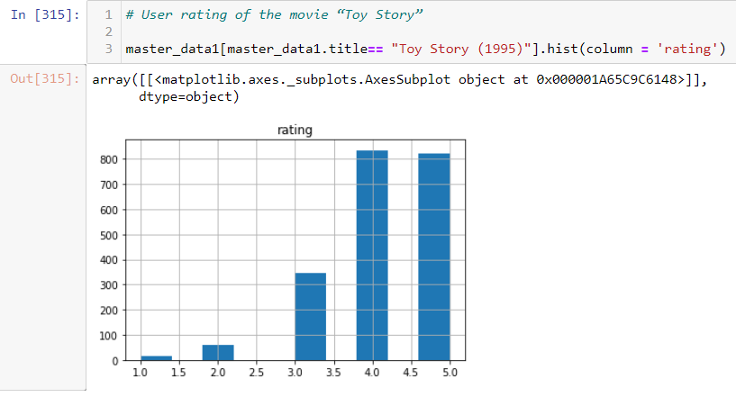
Analysis tasks and Screen shots of Results (cont.):
Master dataset by joining three datasets
Visual distribution of user age and rating of the movie “Toy Story”.

Slide 5
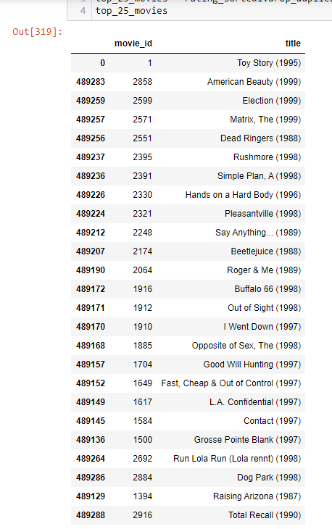
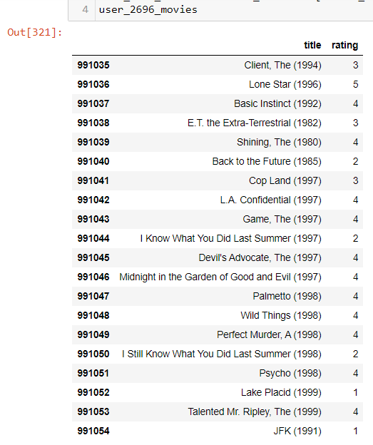
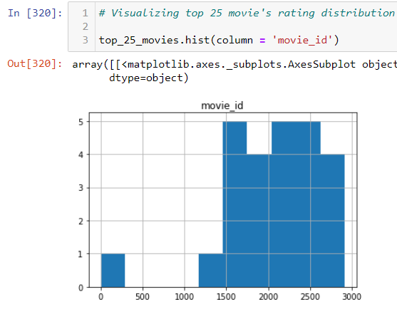
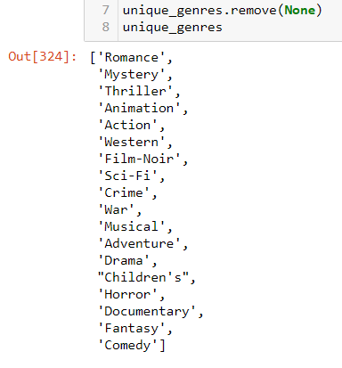
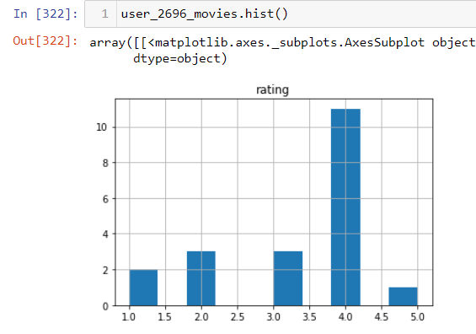
Top 25 movies by viewership movie rating of user id = 2696 List of unique Genres

Slide 6
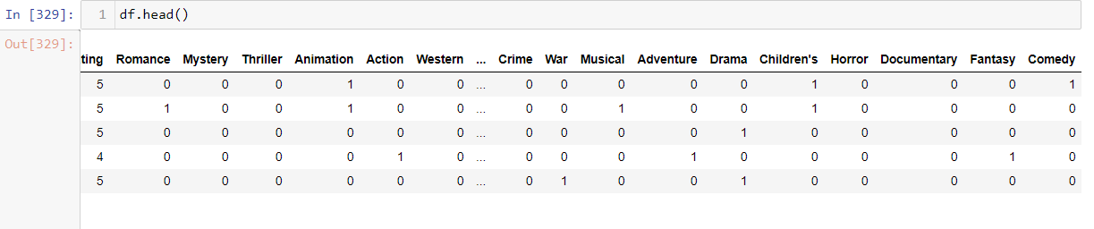
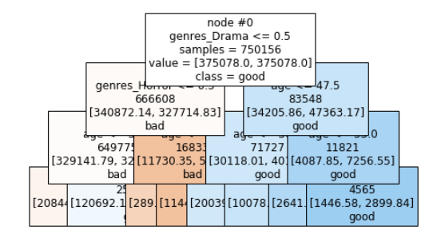
Each Genre with hot-encoding 0 & 1
Decision Tree Model to predict Movie Rating
Conclusions:
User age histogram shows that most users are between 25 – 30 years age category
“Toy Story” movie rating histogram shows that the movie has mostly 4 and 5 (Good) ratings.
Top 25 movies histogram shows that mostly top movies IDs are 1500 to 2500 range.
User with ID 2696 has rated 4 to maximum movies
Based on contextual analysis and domain knowledge, it is concluded that movie_id, user_id, zip, timestamp are the features that do not affect the movie rating. Hence, Age, and Gender could be considered as affecting feature the target variables and would be taken for further model building.
The target variable has 5 categories. So, It is a classification problem. A variety of predictive models can be used. I have chosen Decision Tree model for predicting the movie rating. After building the decision tree model, it is found that the accuracy is about 53% which is low. .So we can try with some other feature columns to fine tune the model

Slide 7
Thank You

